Slide 1
SE 1 (Web Development Course)
Section 1 (intro)

Slide 2
What is web development?
Web development:
Is the process of building websites or web applications
For examples:
Social websites like Facebook, twitter, instgram, …
Commercial websites: souq.com, amazon, …
…

Slide 3
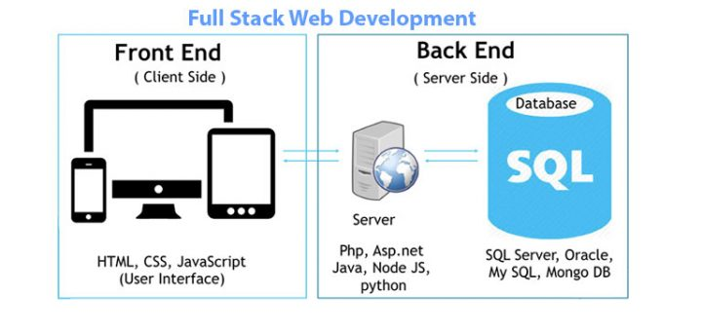
Web development – developers
Web development developers are divided into 3 main categories:
Front end
Back end
Full stack (front end & back end)

Slide 4
Full stack developer
Skills:
Frontend skills:
Basics: HTML, CSS, JavaScript
Frameworks: React, Vue, Angular, Webpack
Styles: Bootstrap, Material UI
Backend skills:
Technology: PHP, Python, ASP .net, Java (Spring)

Slide 5
Full stack developer
Skills:
Database skills:
RDBMS: Oracle, MySQL
NoSQL: MongoDB, Cassandra, CouchDB
Graph: Neo4j

Slide 6
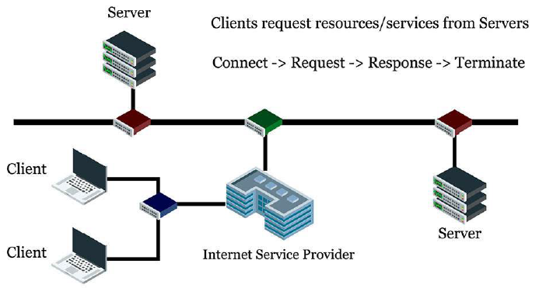
Client and Server

Slide 7
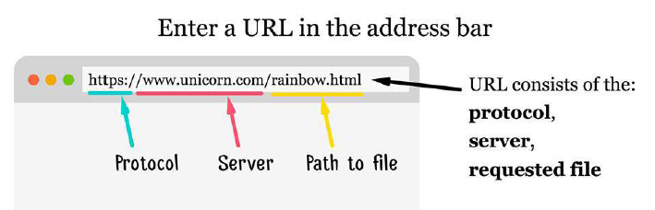
Client and Server
From server to your browser

Slide 8
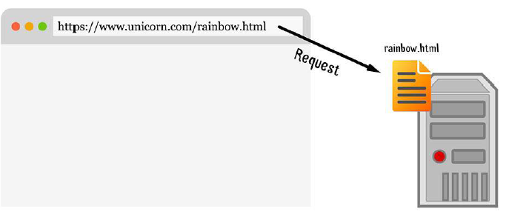
Client and Server
Browser send a request to the server then the server locates the requested file

Slide 9
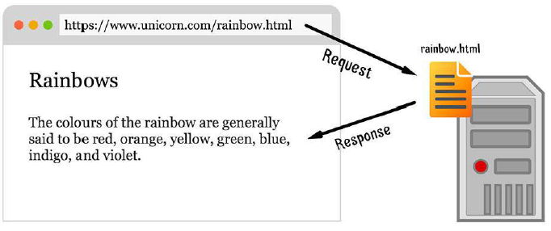
Client and Server
The server returns the file to the browser which displays it

Slide 10
Tools
01
02
Code Editor (Visual Studio Code)
Browser (Chrome)

Slide 11
Visual Studio (VS) Code
Download link:
https://code.visualstudio.com/download
Installation

Slide 12

Thanks

